Slide 1
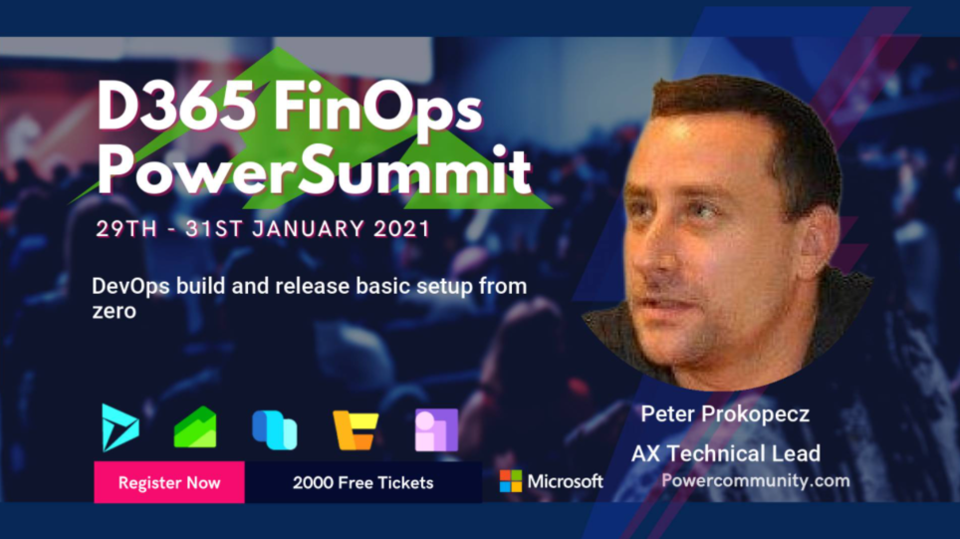

Slide 2
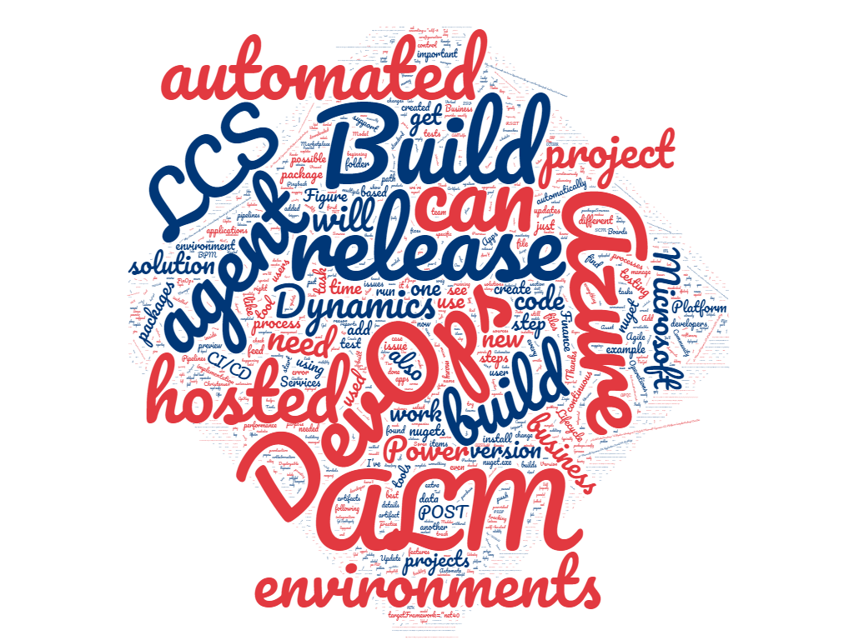
DevOps build and release
MsDyn365FO
Peter Prokopecz

Slide 3
Introduction
Peter Prokopecz
AX technical lead @ JJ Food Service Ltd. (Food wholesale)
Owner @ DAXVision ERP Consulting Ltd. (Your external AX tech. team)
http://www.daxvisionerp.com/
info@daxvisionerp.com
Studies: IT engineer (2006) + MBA (2019)
Experience: AX from 2003
https://www.linkedin.com/in/peter-prokopecz/
Running, Football, Thai boxing, CrossFit, Stocks (ETF), Travel, Language, Menza HungarIQa, card and bord games,...

Slide 4
What will I talk about?
Azure DevOps overview
Creating a Build VM and Pipeline
Automatic start and stop of VM
Release (automatic upload to LCS)
Hosted Agent (build without a VM)

Slide 5

Azure DevOps overview

Slide 6
What is Azure Devops
TFS (repository) -DevOps
Evolution:
Developer code repository ->
Project tool,
Test tool,
CI/CD

Slide 7
Demo
Peter! Dont forget to start the build ;)

Slide 8
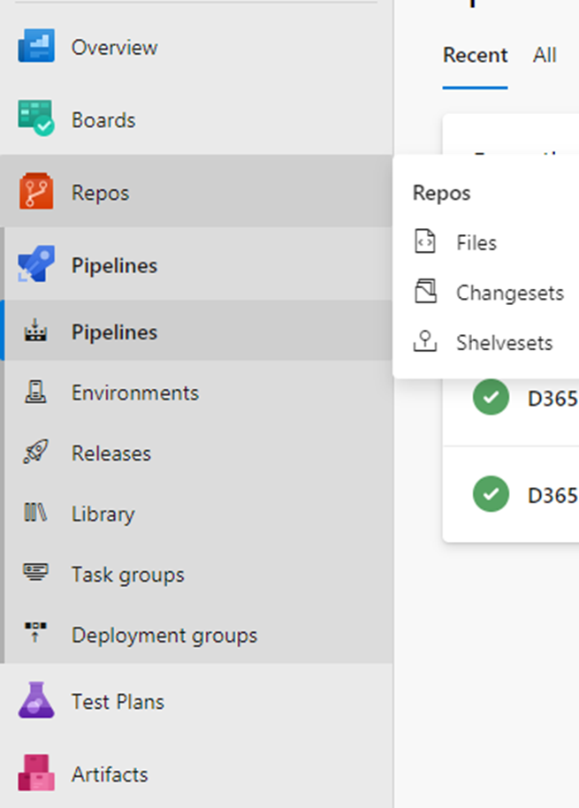
Azure DevOps Services
Azure Repos
Azure Boards
Azure Pipelines
Testing (RSAT, BPM, Task Recorder)
Azure Artefacts

Slide 9
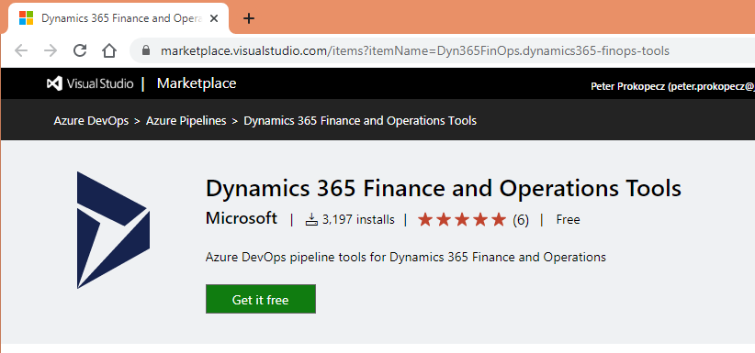
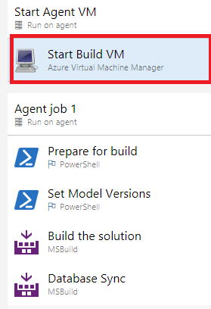
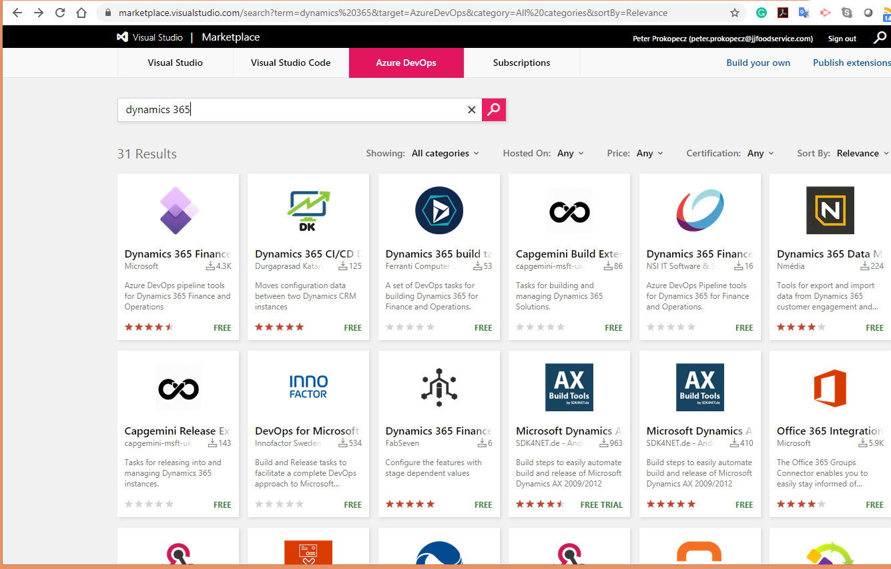
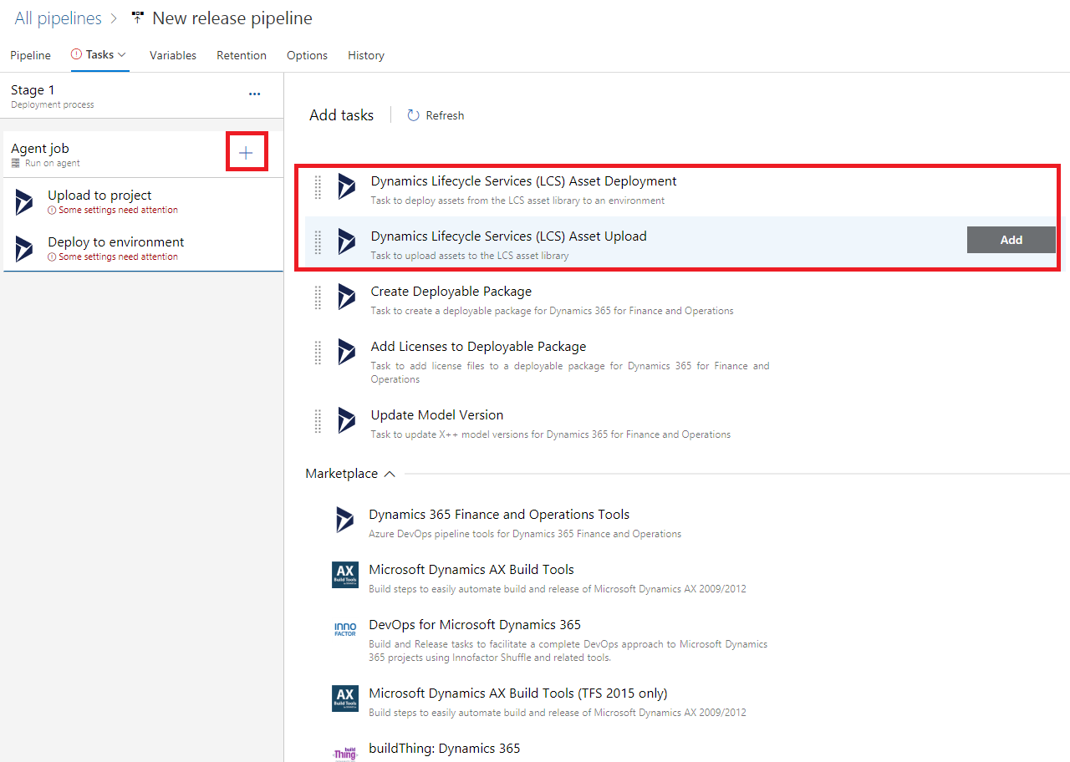
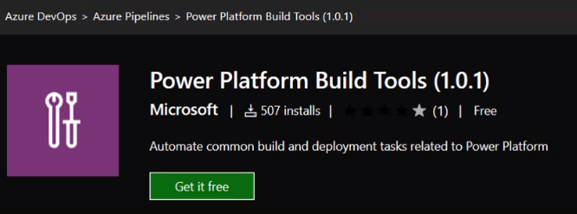
Extensions

Slide 10
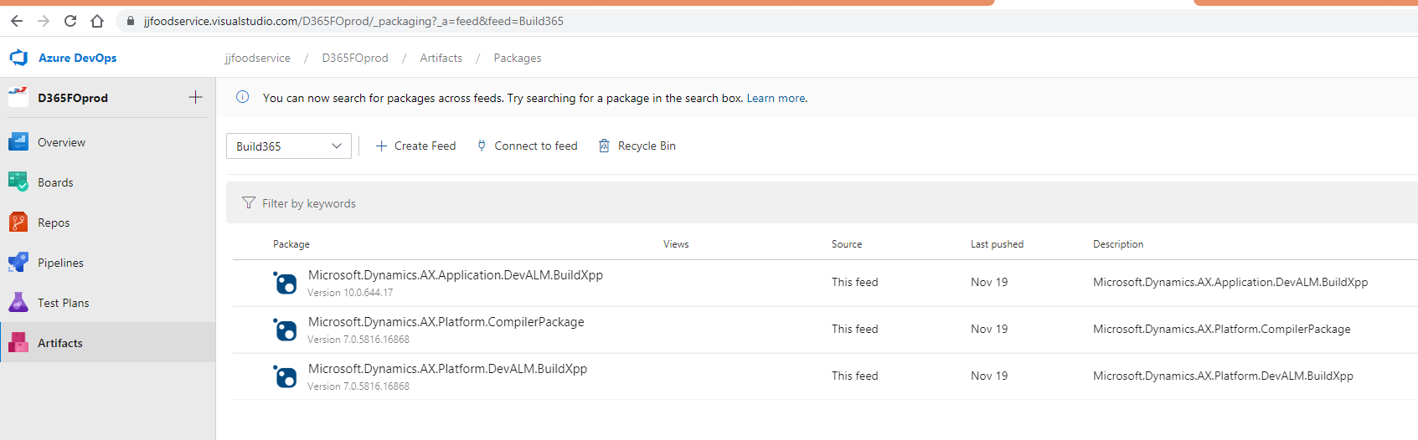
Artifacts
Create Maven-, npm-, NuGet- Python- pagages

Slide 11
Creating a Build VM and Pipeline

Slide 12


How to set up a build server
Step 1: runbook configuration.xml
Step 2: registry setting ...
(DevOps-LCS link setup https://docs.microsoft.com/en-us/dynamics365/fin-ops-core/dev-itpro/perf-test/continuous-build-test-automation)

Slide 13
Demo

Slide 14
Automatic start and stop of VM

Slide 15
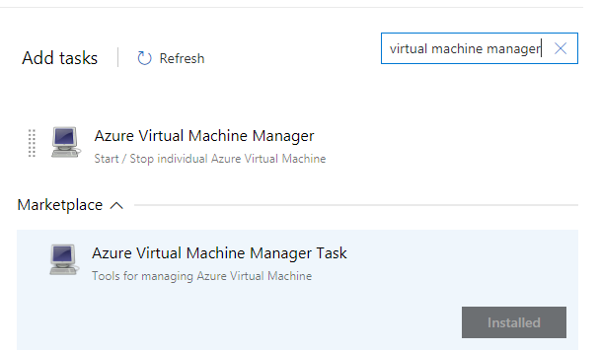
Extension
https://ievgensaxblog.wordpress.com/2019/10/04/msdyn365fo-how-to-automatically-start-a-build-vm-for-a-build/amp/

Slide 16
Demo
Peter! Dont forget to check/show the status of the running build!

Slide 17
Release (automatic upload to LCS)

Slide 18
Every FinOps projects install Dynamics 365 Finance and Operations Tools created by Microsoft,
create a new release pipeline and add “Dynamics Lifecycle Services (LCS) Asset Upload” and “Dynamics Lifecycle Services (LCS) Asset Deployment” steps

Slide 19
Demo

Slide 20
Hosted Agent (build without a VM)

Slide 21
Demo

Slide 22
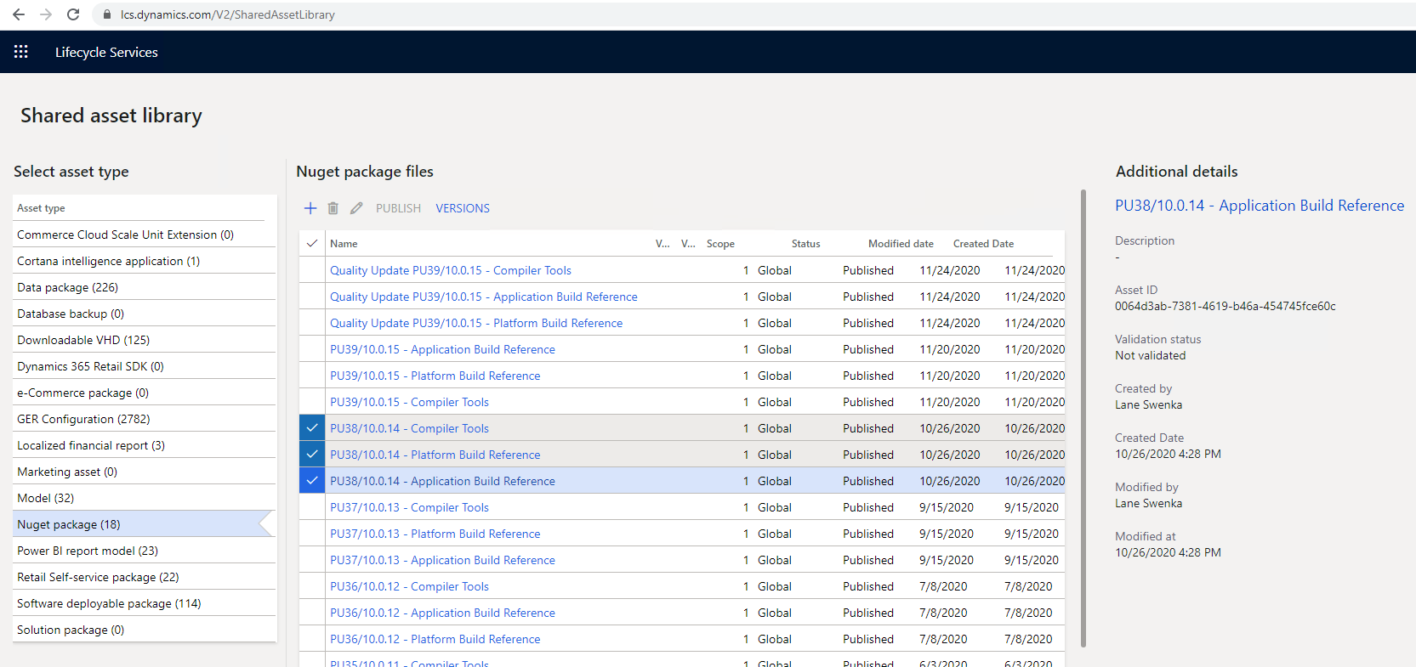
https://docs.microsoft.com/en-us/dynamics365/fin-ops-core/dev-itpro/dev-tools/hosted-build-automation?WT.mc_id=BA-MVP-5003976
https://ariste.info/en/2020/05/azure-hosted-build-dynamics365-finance-scm/

Slide 23
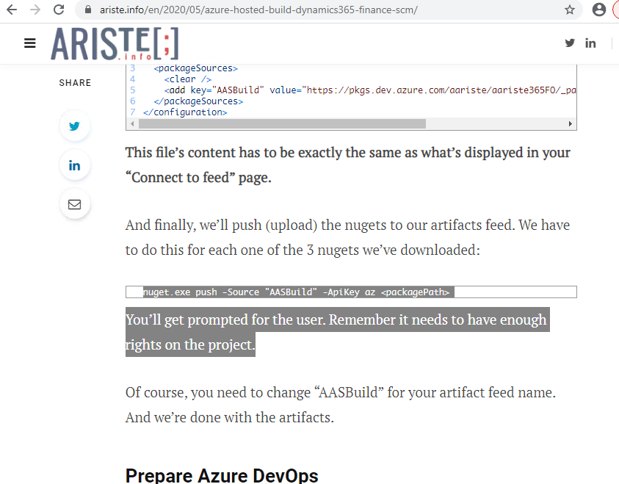

Slide 24
Errors
Unable to load the service index for source https://jjfoodservice.pkgs.visualstudio.com/D365FOprod/_packaging/Build365/nuget/v3/index.json.
Response status code does not indicate success: 401 (Unauthorized).
NuGet.Config does not contain the expected root element: 'configuration'. Path: 'C:\_HostedAgentNuget\NuGet.Config’.
File does not exist (C:\_HostedAgentNuget).

Slide 25
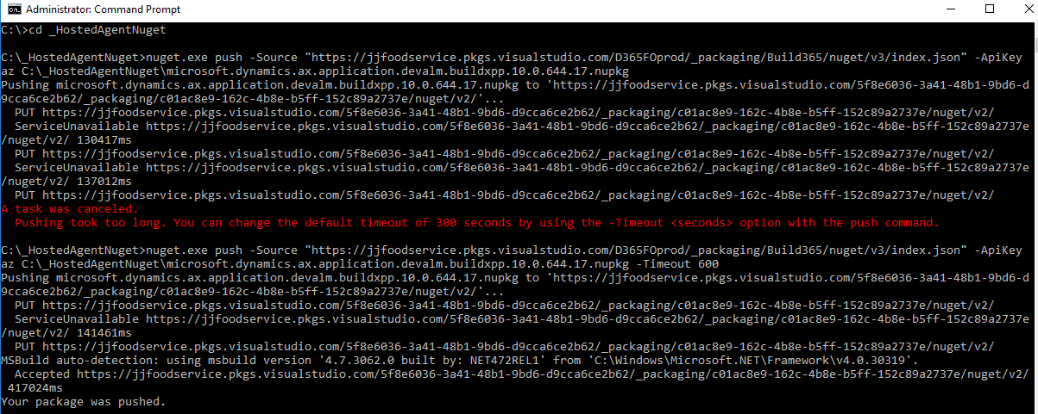
A task was canceled.
Pushing took too long. You can change the default timeout of 300 seconds by using the -Timeout <seconds> option with the push command.

Slide 26
nuget.exe push -Source "https://....pkgs.visualstudio.com/D365FOprod/_packaging/Build365/nuget/v3/index.json" -ApiKey az C:\_HostedAgentNuget\microsoft.dynamics.ax.application.devalm.buildxpp.10.0.644.17.nupkg
nuget.exe push -Source "https://....pkgs.visualstudio.com/D365FOprod/_packaging/Build365/nuget/v3/index.json" -ApiKey az C:\_HostedAgentNuget\microsoft.dynamics.ax.platform.devalm.buildxpp.7.0.5816.16868.nupkg
nuget.exe push -Source "https://....pkgs.visualstudio.com/D365FOprod/_packaging/Build365/nuget/v3/index.json" -ApiKey az C:\_HostedAgentNuget\microsoft.dynamics.ax.platform.compilerpackage.7.0.5816.16868.nupkg -Timeout 600

Slide 27
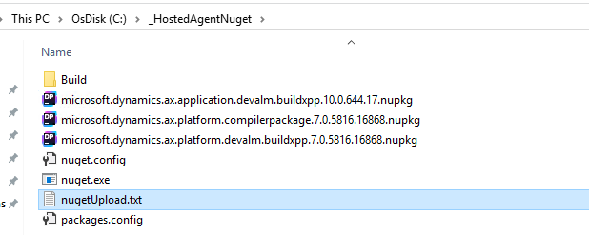

Slide 28
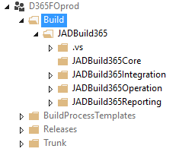
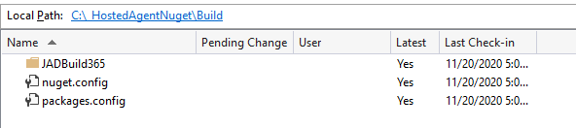
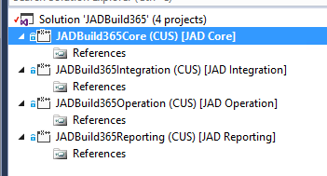
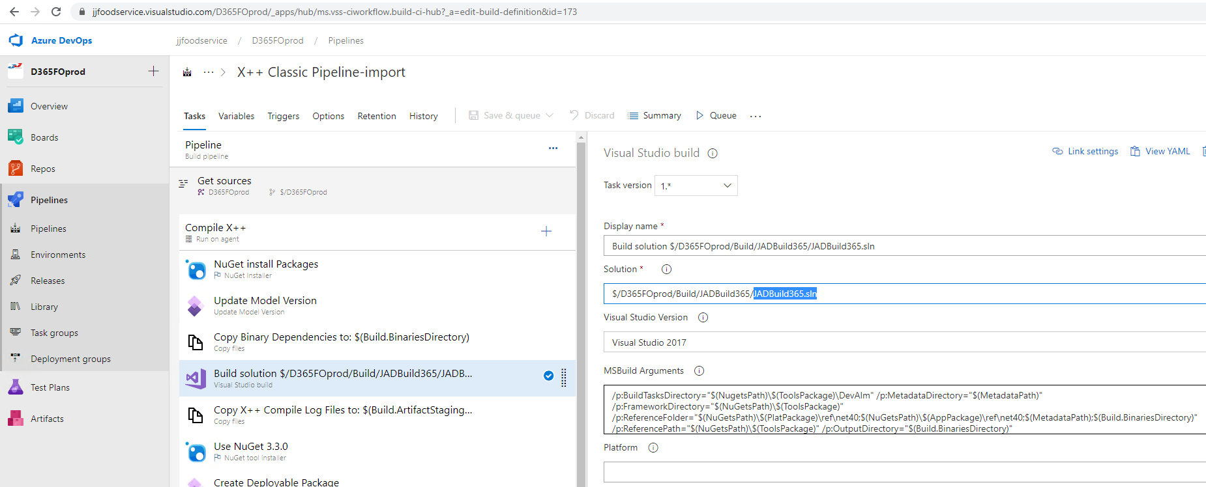

Slide 29
What have I talked about
Azure DevOps overview
Creating a Build VM and Pipeline - Peter! Dont forget to check/show the status of the running build!
Automatic start and stop of VM
Release (automatic upload to LCS)
Hosted Agent (build without a VM)

Slide 30
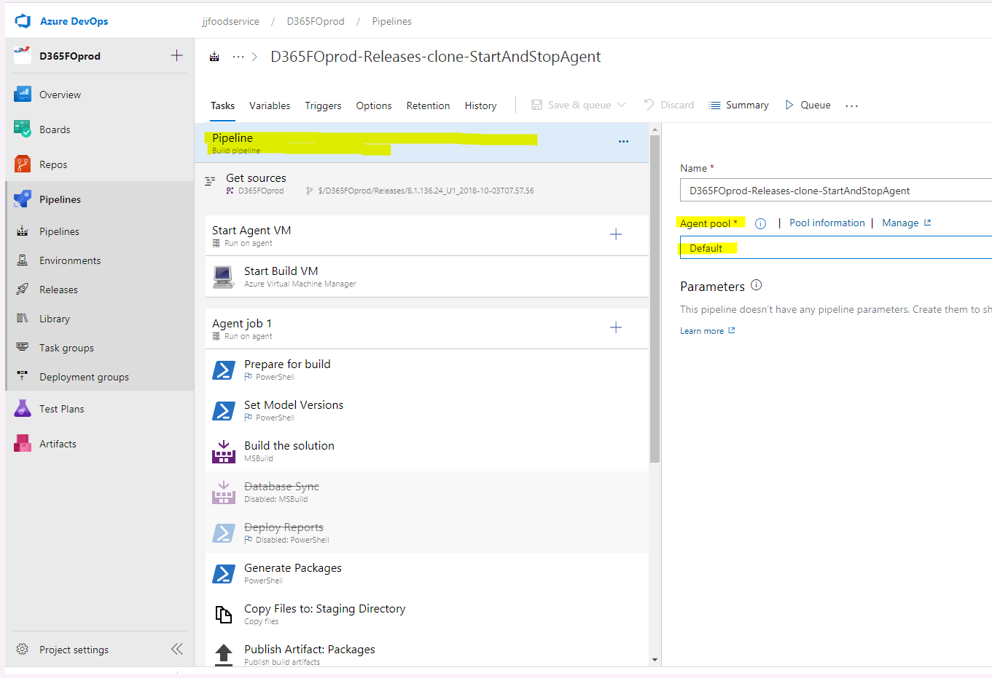
Q&A
Question: where to set which build VM to use for the build?
Answer: It is set by the agent pool. You can add more agents to an agent pool and one that is awailable will start the build. See screenshot on the right.
Q: Can I use one build VM for more builds (per branch for example)?
A: Yes, the build VM is cleaned and the code is pulled for every build process. You need to pay attentiont to the D365 versions.

Slide 31
Thank you
Peter Prokopecz
info@daxvisionerp.com
DAXVision ERP Consulting Kft.
http://www.daxvisionerp.com/

